Slide 1
Predicting if an employee is a smoker
By Dana Kaiboussi

Slide 2

How can we reduce the company's costs related to smoking?
Image from https://cdn.beam.usnews.com/

Slide 3
Current health care costs of smoking
Ohio State University Study states that companies pay almost $6,000 extra per year for each employee who smokes.
https://tobaccofree.osu.edu/research/study-companies-pay.html

Slide 4
Ohio State University Study Continued
By drawing on previous research on the costs of absenteeism, lost productivity, smoke breaks and health care costs, the researchers developed an estimate that each employee who smokes costs an employer an average of $5,816 annually above the cost of a person who never smoked. These annual costs can range from $2,885 to $10,125, according to the research.

Slide 5
Ohio State University Study Continued
Smoke breaks accounted for the highest cost in lost productivity, followed by health-care expenses that exceed insurance costs for nonsmokers.

Slide 6
Current Smokers
Based on our 2019 Open Enrollment data:
8,972 employees currently identify themselves as a smoker.
Based on the Ohio State study, the company is spending approximately $53,832,000 per year extra on smokers. ($6,000 * 8,972 current smokers)

Slide 7
Smoker Cessation Programs
How can we make a smoker cessation program successful?
Identify employees who are smokers, or who may be a smoker in the future, and target communications to this group.

Slide 8
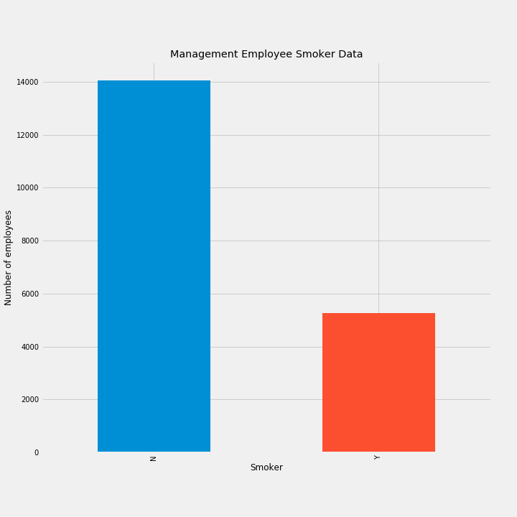
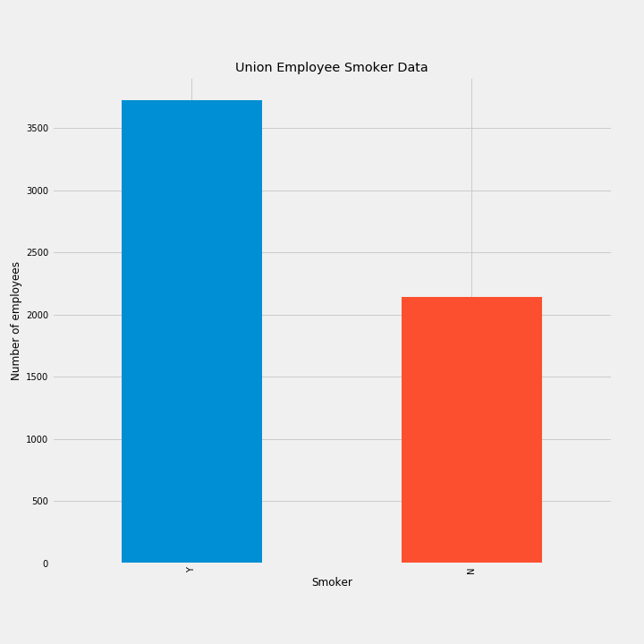
Current employee smoker data

Slide 9
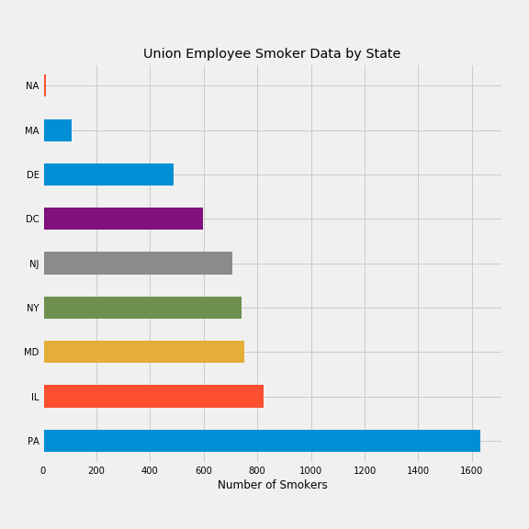
Count of all employees in each work state:
MD 6421 IL 6401 PA 5298 NY 1852 DC 1398 NJ 1290 DE 1181 TX 424 MA 206 NA 166 WI 152 KY 81 TN 44 CA 37 GA 35 MI 29 AL 26 OH 18 IA 15 KS 12
FL 9 CT 8 NC 7 NE 6 MN 6 NH 5 NV 4 AZ 4 VA 4 SC 4 IN 3 OR 2 OK 2 MO 2 AR 2 CO 2 UT 2 RI 1 WA 1 WY 1

Slide 10
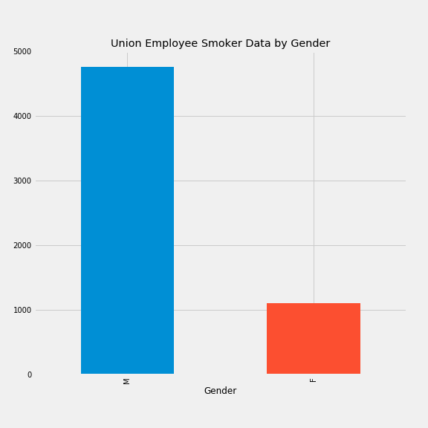

Slide 11
Can we predict who is a smoker?
If we know what type of employee is more likely to be a smoker, we can predict the highest population of smokers and be able to promote the smoker cessation program effectively.

Slide 12
Future smokers
Based on the data we have today, we can see a correlation between being in a union, being a male and an employees age. Knowing this information, the company can promote the smoker cessation program at different points in time to people who meet this criteria.

Slide 13
When running the prediction models:
Based on the prediction model created, it can correctly predict if an employee is a smoker 71% of the time.
Union - Y, gender - M, Age - 31 = Smoker - YES Union - Y, gender - F, Age - 31 = Smoker - NO Union - N, gender - M, Age - 31 = Smoker - NO Union - N, gender - F, Age - 31 = Smoker - NO

Slide 14
Areas to promote the program
New Hire materials
Links on benefits website to the smoker cessation program administrator
Paper mail campaigns
Open Enrollment benefit fairs at specific locations

Slide 15
Why?
Employer Pros: Taking a more proactive approach to helping our employees stop smoking will help reduce unnecessary expenses for our company (direct health care costs, reduce the use of sick time, and eliminate smoke breaks)
Employee Pros: Living a longer, healthier life!

Slide 16
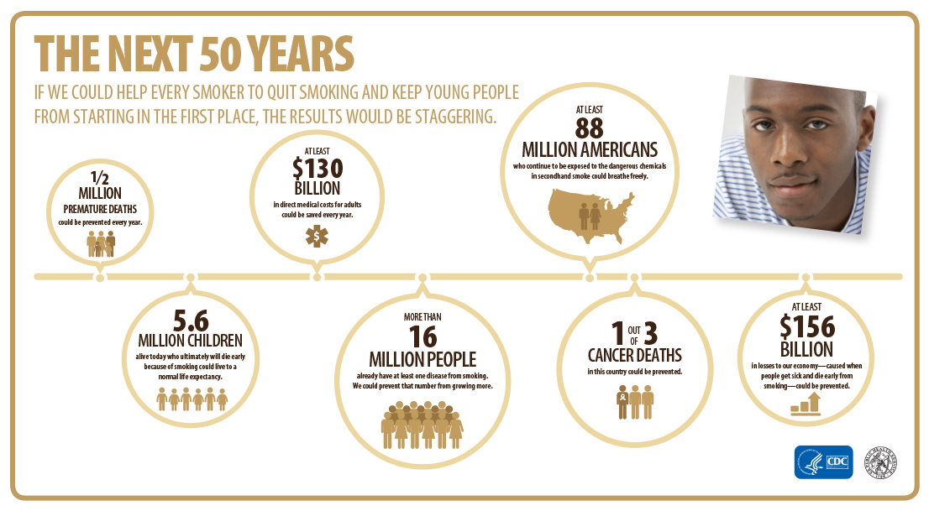

Slide 17
questions?

